Slide 1
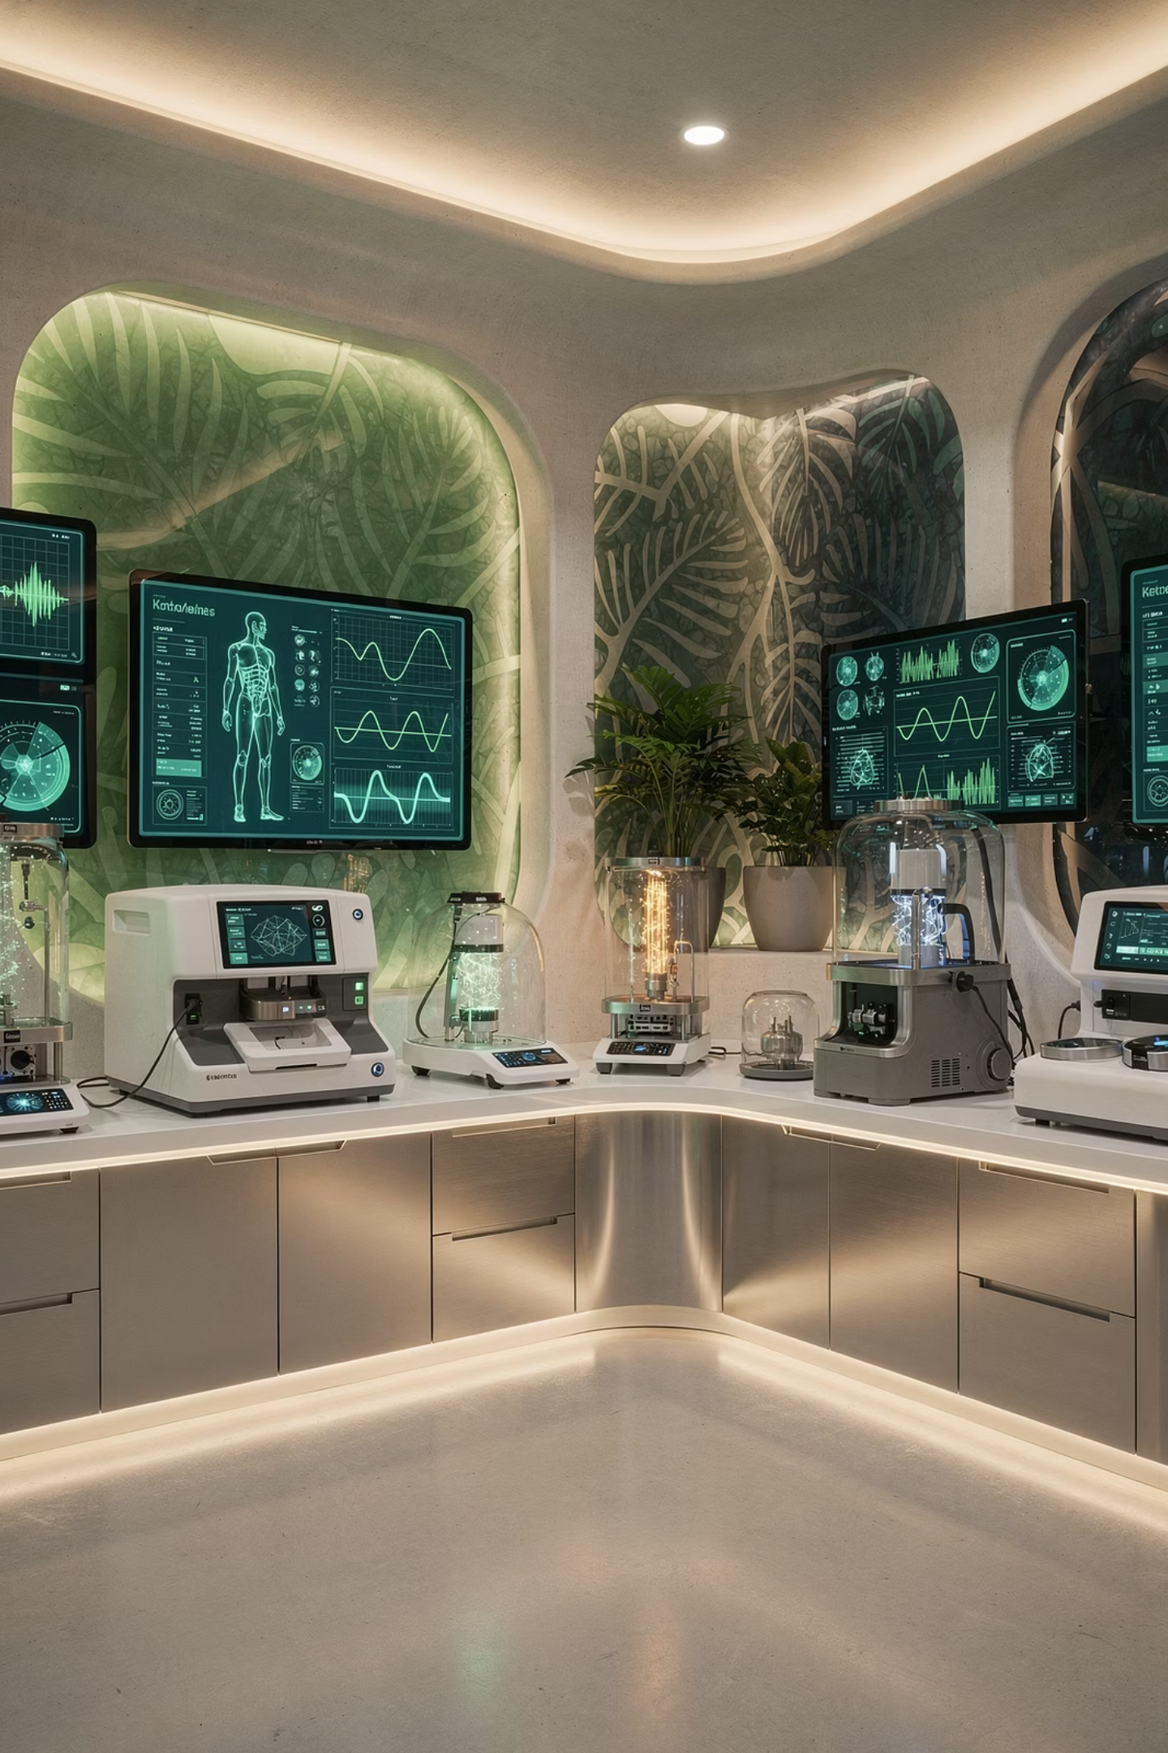
NALA medtch
In touch with tomorrow — the future of healthcare
A health-technology and services company advancing diagnostics, advisory, skincare manufacturing, medical supply, and AI-driven solutions to elevate care quality, access, and efficiency across Egypt and Africa.

Slide 2
Mission & Vision
Mission
Vision
To accelerate better patient outcomes by integrating advanced diagnostics, expert advisory, and intelligent technologies across the healthcare ecosystem.
To shape a smarter, more accessible, and data-driven healthcare future across Egypt and the African continent — improving quality, affordability, and scalability of care.

Slide 3

Our Core Values
Vision
Ownership
Anticipate needs and innovate with purpose.
Act with accountability, integrity, and measured impact.
Execution
Deliver reliably, at speed, with measurable results.

Slide 4

Core Businesses
Diagnostic Laboratory Services
Healthcare Advisory
Skincare Development & Manufacturing
Expert guidance to optimize healthcare systems and outcomes.
Advanced diagnostics to support accurate, timely clinical decisions.
Formulating and producing high-quality skincare solutions.

Slide 5
More Core Businesses
Laboratory Advisory & Trading
Medical Supply for Hospitals
AI Solutions in Healthcare
Supplying and advising on laboratory equipment and consumables.
Reliable procurement and delivery of critical medical supplies.
Intelligent, data-driven tools to transform care delivery and efficiency.

Slide 6

Core Strategy
Hiring and empowering a strong, multidisciplinary team to develop and scale transformative healthcare solutions.
NALA medtch's growth is driven by people — building teams with the expertise, accountability, and ambition to deliver meaningful change across the healthcare landscape.

Slide 7


Our Geographic Focus
Egypt
Africa
Headquarters and primary market, driving innovation in diagnostics and health services.
Expanding access to quality, affordable, and scalable healthcare across the continent.

Slide 8
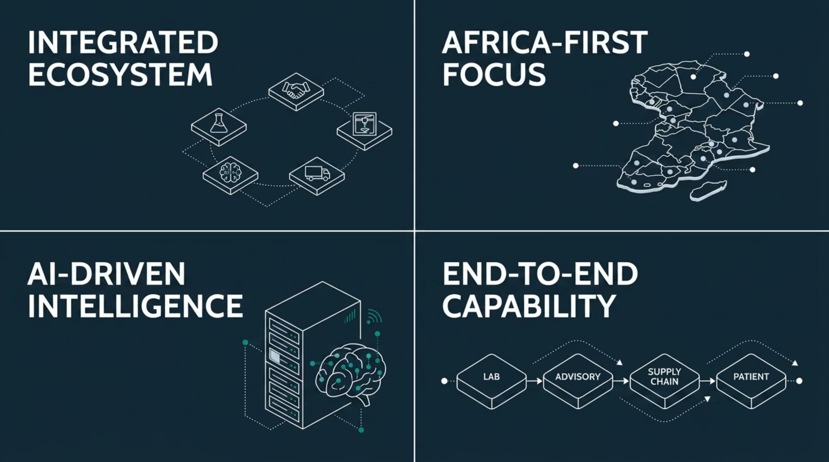

What Sets NALA medtch Apart

Slide 9

The NALA medtch Ecosystem
Advise
Healthcare and laboratory advisory
Diagnose
Deliver
Lab services and AI diagnostics
Skincare, supplies and AI solutions
From diagnostics to delivery, NALA medtch connects every link in the healthcare value chain — ensuring quality, speed, and impact at every stage.

Slide 10


In Touch with Tomorrow
VISION. OWNERSHIP. EXECUTION.
NALA medtch advances diagnostics, advisory, skincare manufacturing, medical supply, and AI to improve healthcare quality and access across Egypt and Africa.
Together, we are shaping a smarter, more accessible, and data-driven healthcare future for Egypt and the African continent.

